Slide 1


DIABETES DETECTION USING DEEP LEARNING
Guided by,
MRS.Rajeswari ,
Placement Trainer,
Karpagam Institute of Technology,
Coimbatore.
Presented by
DHARSHINI S (721221243015),
KEERTHIKA G(721221243030),
PRANESH RK(721221243043),
SATHISH KUMAR S(721221243056)
Department of Artificial Intelligence and Data Science,
Karpagam Institute of Technology,
Coimbatore.

Slide 2
ABSTRACT
Diabetes, also known as Diabetes Mellitus, is a disease that happens to a person when one’s blood glucose or blood sugar is extremely high. Insulin is a hormone secreted by the organ pancreas and helps to convert the blood glucose into useful energy for the body.
In some cases, the body doesn’t produce enough, or any amount of insulin or doesn’t use the produced insulin properly. Hence the Glucose remains in the blood and doesn’t reach the body cells.
Thus, having a lot of glucose in your blood can causes health problems, which is what exactly happens in Diabetes. Long- term complications of Diabetes develop gradually. Having Diabetes for a long time along with uncontrolled blood sugar levels can cause dangerous complications.
In the due course, diabetes complications may be disabling or even life-threatening. Making things even worse, there is no cure for this disease yet! Even though there’s no cure for diabetes, it can be treated and controlled, and some people may go into a state of remission.
But the very first step towards controlling and minimizing the ill effects of Diabetes is – the early detection of the disease! Thus, we need comfortable, reliable, and quick methods of detection.
Hence, we are proposing an efficient, reliable, comfortable, and time-saving Diabetes detection system for Diabetes detection using diabetic Retinopathy and Implementation of Convolutional Neural Networks (CNN). The level of Diabetic retinopathy present will also give a direct indication about the level of Diabetes.
The implementation of this method of Diabetes detection will increase accuracy, efficiency, and ease of Diabetes detection, and further the prognosis and treatment. Also, it will prove to be a better alternative to conventional testing for the disease.

Slide 3
OBJECTIVE
OBJECTIVE:
The objective of using deep learning for diabetes detection is to leverage advanced computational models to analyse medical data and identify patterns that can assist in the early detection or monitoring of diabetes. Early detection is crucial for timely intervention and effective management of the disease. Here are the key objectives:
1. Early Detection
2. Accuracy and Precision
3. Feature Extraction
4. Personalized Medicine
5.Real-time Monitoring
6.Explainability and Interpretability
7. Scalability and Generalizability
8. Ethical Considerations

Slide 4
EXISTING SYSTEM:
Blood Glucose Monitoring Devices:
These devices measure blood glucose levels through a small blood sample obtained via fingerstick or continuous glucose monitoring (CGM) systems. They are commonly used for diabetes diagnosis, management, and monitoring of blood sugar levels over time.
Hemoglobin A1c (HbA1c) Testing: HbA1c tests provide an indication of average blood glucose levels over the past two to three months. This test is widely used for diagnosing diabetes and monitoring long-term glycemic control in individuals with diabetes.

Slide 5
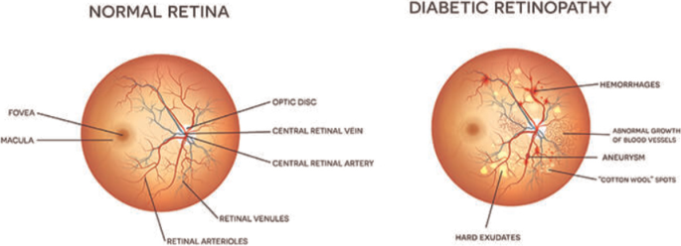
PROPOSED SYSTEM AND MODULES
The Proposed project uses the features of the Retina to detect the presence of Diabetes in an Individual. Diabetic Retinopathy screening is the working principle here, and accurate detection and good progress can be made using image classification and pattern recognition.
Following are the Prime concepts used in the implemented project:
DIABETIC RETINOPATHY: This is an after-effect of diabetes that damages the eyes. Diabetic retinopathy is brought about by harm to the veins in the body tissues at the backside of the eye (retina).

Slide 6
PROPOSED SYSTEM AND MODULES
CONVOLUTIONAL NEURAL NETWORK:
DL model comprising pre-processing and classification stages was proposed in. Retinal images from different data sets were extracted to standardize their size in the pre-processing stage, and a CNN algorithm was used to generate the classification. An end-to-end CNN model was proposed for the grading of the severity of diabetic diagnosis. After cropping and resizing the image, the red, green, and blue channels were scaled to zero mean and unit variance. The model comprised three convolutional blocks and one block of fully connected layers, and the number of training samples was enhanced through data augmentation techniques.

Slide 7
Implementation Methodology:
We have high resolution Retina Images of the person to be tested as input data. A left and Right eye image (Retina Image) is present for each subject. Our proposed automated system will detect the presence of Diabetes in the individual based on Diabetic Retinopathy.
The system will also predict the level of Diabetes in each subject on a scale of 0 (zero) to 4 (four) according to the following considerations:
0-non-Diabetic
1-Mild
2-Moderate
3- Severe
4- Proliferative Diabetes

Slide 8
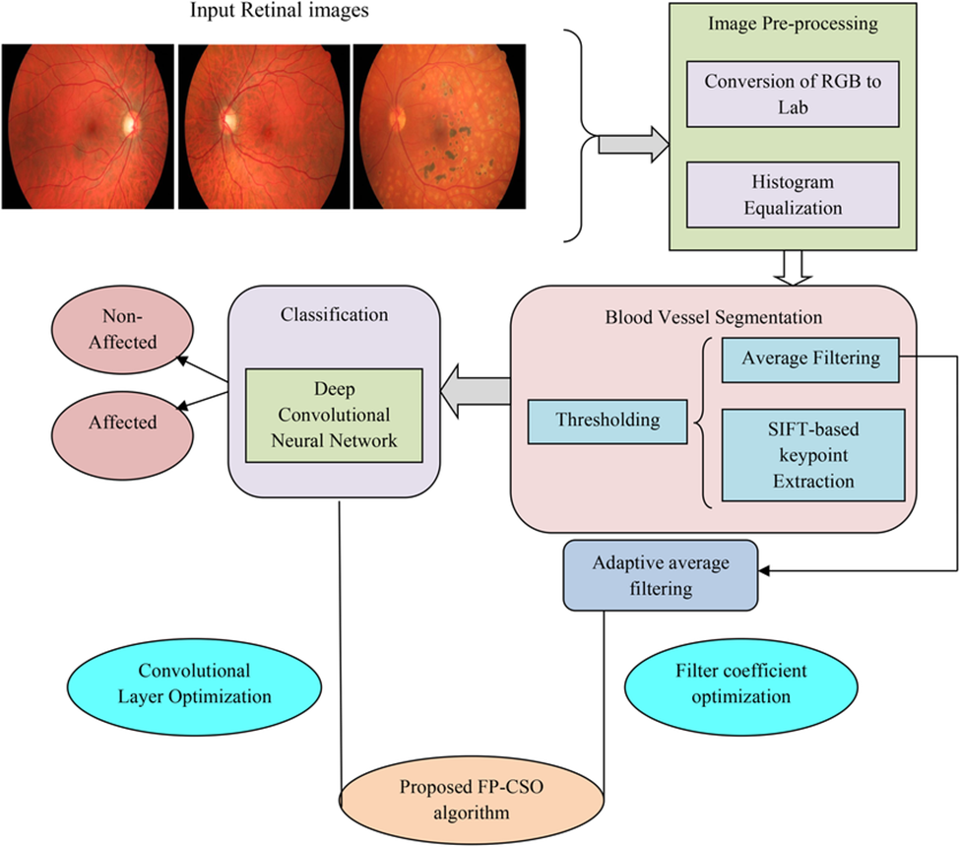
FLOW DIAGRAM

Slide 9
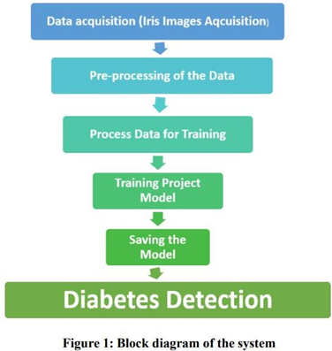
FLOW DIAGRAM

Slide 10
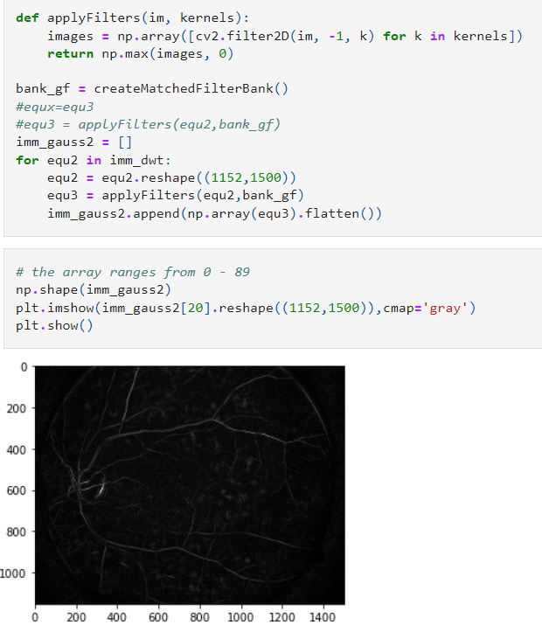
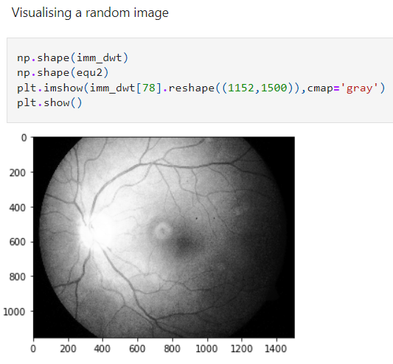
Image Processing Screenshot

Slide 11
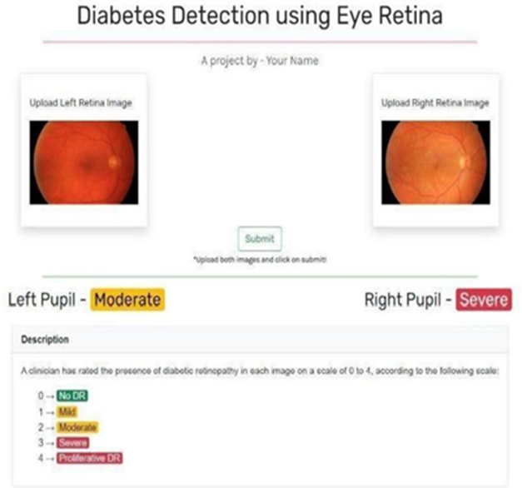
DIABETES DETECTION USING EYE RETINA

Slide 12
REFERENCE
1.Diagnosis of Diabetes using Computer Methods: Soft Computing methods for Diabetes detection using Iris, World Academy of Science, Engineering and Technology Conference, pages 1-6, 2019
2.Diabetes Prediction System based on Iridology using Machine Learning, IEEE Conference, Semarang, Indonesia, pages 1-9, 2011
3.Iridology Simplified by Bernard Jensen, Book Pub Co; 5th Edition, 2011.
4.Neural Networks and Deep Learning by Pat Nakamoto, CreateSpace Independent Publishing Platform, 2018.
5.Christopher picture publications, https:// www. christopherpublications.com/Iridology.html, Accessed 13 Mar. 2011
6.Carolina Research, https:// www. carolinaeyecare. com/retina- charleston/diabeticretinopathy/, Accessed 12 April, 2003
7.Science direct research, https:// www. sciencedirect.com/science/article/abs/pii/S0045790618302556, Accessed 8 January, 2011

Slide 13
THANK YOU!

